Slide 1
Introduction to Computer Science and Programming
Labo 16 – C++ Dynamic allocation and dynamic arrays
Laboratory 16, April 09, 2026
Filippo Ricca & Muhammad Mohsin
DIBRIS, University of Genova

Slide 2
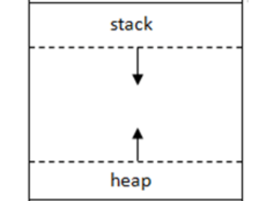
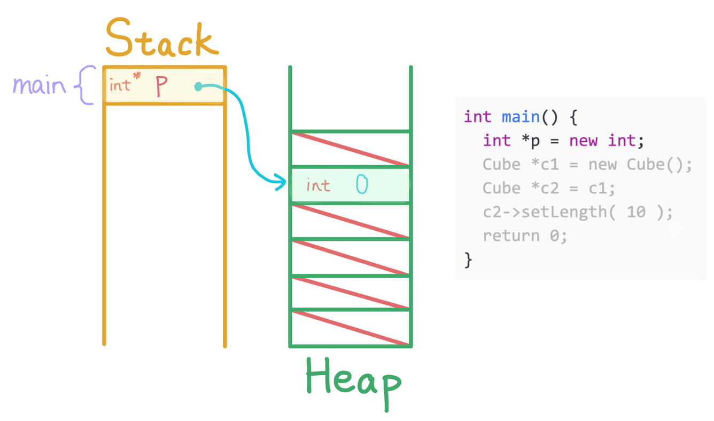
Today…
Today's lab is dedicated to dynamic allocation and dynamic arrays
Exercise 1: Resizing Dynamic Array
Exercise 2: Dynamic Array Reversal
Exercise 3: Greater than Average Number
Exercise 4: Dynamic Odd Number
Exercise 5: Dynamic 2D Array Allocation
Exercise 6: Memory Leak in dynamic allocation
All the C++ program must be delivered on Aulaweb!
Notes:
Today we will do Dynamic allocation and dynamic arrays exercises.

Slide 3
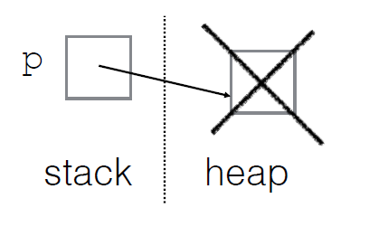
Dynamic Allocation
Dynamic memory allocation is the process of allocating memory at the runtime of a program.
In dynamic memory allocation, we allocate and then deallocate memory dynamically using the new and delete operators respectively.
p = new type; p = new type [number_of_elements];
Delete [] p;

Slide 4
Heap Memory
This allocation performed in the Heap memory of the program instead of the stack memory.
Why?
When you are not sure about the size of the array you need.
Implementing data structures such as linked list, trees, etc.
In complex programs that require efficient memory management.
Example.

Slide 5
Declaration of dynamic array
dataType* arrayName = new dataType[size];
int size = 5;
int* dynamicArray = new int[size]; // Allocates array of 5 integers
Remember that dynamic array could be of any size defined by the user, for instance in above example, size=5

Slide 6
Exercise 1: Resizing a Dynamic Array
Write a C++ program in which the user dynamically allocates an array of ‘n’ integers. When the array becomes full, create a new array with 2 × current capacity, copy all existing elements into it, delete the old memory, and continue using the new array.
Example: If capacity = 4 and array is full, create a new array of capacity = 8.
Hint: Use dynamic memory allocation
(new / delete[]) and copy elements before freeing the old array.
Notes:
#include <iostream>
using namespace std;
int main() {
int capacity;
// Get initial capacity from user
cout << "Enter initial array capacity: ";
cin >> capacity;
// Dynamically allocate initial array
int* arr = new int[capacity];
int size = 0;
cout << "\nEnter integers to insert (-1 to stop):\n";
int value;
while (true) {
cout << "Enter value: ";
cin >> value;
if (value == -1)
break;
// Check if array is full — if so, double the capacity
if (size == capacity) {
int newCapacity = capacity * 2;
cout << "\n [!] Array full (capacity = " << capacity << ")"
<< " → Doubling to capacity = " << newCapacity << "\n\n";
// Step 1: Allocate new larger array
int* newArr = new int[newCapacity];
// Step 2: Copy all existing elements into new array
for (int i = 0; i < size; i++)
newArr[i] = arr[i];
// Step 3: Delete old array
delete[] arr;
// Step 4: Point to new array and update capacity
arr = newArr;
capacity = newCapacity;
}
// Insert value into array
arr[size++] = value;
}
// Print final array
cout << "\nFinal array (size = " << size
<< ", capacity = " << capacity << "):\n[";
for (int i = 0; i < size; i++) {
cout << arr[i];
if (i < size - 1) cout << ", ";
}
cout << "]\n";
// Free allocated memory
delete[] arr;
return 0;
}

Slide 7

Exercise 2: Dynamic Array Reversal
Write a C++ program that dynamically allocates an integer array of size ‘n’, initializes it with values 1 to n, then reverses the array (without using extra memory)
For Example:
Enter array size: 5
Original array: 1 3 5 7 9
Reversed array: 9 7 5 3 1
Don’t forget to deallocate the dynamic memory to avoid memory leaks
Notes:
#include <iostream>
using namespace std;
int main() {
int n;
// Get array size from user
cout << "Enter array size: ";
cin >> n;
// Dynamically allocate array
int* arr = new int[n];
// Initialize array with values 1 to n (step 2)
for (int i = 0; i < n; i++) {
arr[i] = 1 + 2*i; // Generates odd numbers 1, 3, 5,...
}
// Display original array
cout << "Original array: ";
for (int i = 0; i < n; i++) {
cout << arr[i] << " ";
}
cout << endl;
// Reverse the array in-place (without extra memory)
for (int i = 0; i < n/2; i++) {
// Swap elements from start and end
int temp = arr[i];
arr[i] = arr[n-1-i];
arr[n-1-i] = temp;
}
// Display reversed array
cout << "Reversed array: ";
for (int i = 0; i < n; i++) {
cout << arr[i] << " ";
}
cout << endl;
// Deallocate memory
delete[] arr;
return 0;
}

Slide 8
Exercise 3: Dynamic Odd Number
Write a C++ program in which user dynamically allocate an array of ‘n’ integers. Input ‘n’ values and create another array with only odd numbers.
Example: Input: [2, 3, 5, 8, 11] → Output: [3, 5, 11]
Hint: Use two passes — first to count, second to copy.
Don’t forget to deallocate the dynamic memory to avoid memory leaks
Notes:
#include <iostream>
using namespace std;
int main() {
int n;
// Get array size from user
cout << "Enter number of elements: ";
cin >> n;
// Dynamically allocate the original array
int* originalArray = new int[n];
// Input values from user
cout << "Enter " << n << " integers:\n";
for (int i = 0; i < n; i++) {
cin >> originalArray[i];
}
// First pass: count odd numbers
int oddCount = 0;
for (int i = 0; i < n; i++) {
if (originalArray[i] % 2 != 0) {
oddCount++;
}
}
// Dynamically allocate array for odd numbers
int* oddArray = new int[oddCount];
// Second pass: copy odd numbers
int index = 0;
for (int i = 0; i < n; i++) {
if (originalArray[i] % 2 != 0) {
oddArray[index] = originalArray[i];
index++;
}
}
// Display results
cout << "Original array: [";
for (int i = 0; i < n; i++) {
cout << originalArray[i];
if (i < n - 1) cout << ", ";
}
cout << "]" << endl;
cout << "Odd numbers array: [";
for (int i = 0; i < oddCount; i++) {
cout << oddArray[i];
if (i < oddCount - 1) cout << ", ";
}
cout << "]" << endl;
// Deallocate memory
delete[] originalArray;
delete[] oddArray;
return 0;
}

Slide 9
Exercise 4: Greater than average number
Write a C++ program in which Allocate float array dynamically, find average of the numbers present in arrays.
Then print only the values greater than average value.
Example:
[2.5, 3.5, 6.0, 4.3, 6.7] → Avg = 4.6 → Output: 6.0, 6.7
Don’t forget to deallocate the dynamic memory to avoid memory leaks
Notes:
#include <iostream>
using namespace std;
int main() {
int n;
// Get array size from user
cout << "Enter number of elements: ";
cin >> n;
// Dynamically allocate float array
float* arr = new float[n];
// Input values from user and calculate sum
cout << "Enter " << n << " float numbers:\n";
float sum = 0;
for (int i = 0; i < n; i++) {
cin >> arr[i];
sum += arr[i];
}
// Calculate average
float average = sum / n;
cout << "Average = " << average << endl;
// Print values greater than average
cout << "Values greater than average: ";
bool first = true; // For proper comma formatting
for (int i = 0; i < n; i++) {
if (arr[i] > average) {
if (!first) {
cout << ", ";
}
cout << arr[i];
first = false;
}
}
cout << endl;
// Deallocate memory
delete[] arr;
return 0;
}

Slide 10
Exercise 5: Dynamic 2D Array Allocation
Write a C++ program in which the user dynamically allocates a 2D array of floats with dimensions m × n. Initialize the array with USER INPUT values and print the complete matrix.
Example: Input: m = 3, n = 3 Output: [1.2 3.5 4.1] [5.6 7.3 0.9] [8.1 2.7 3.3]
Hint: Use new to allocate rows first, then allocate columns for each row.
Notes:
#include <iostream>
#include <iomanip>
using namespace std;
int main() {
int m, n;
// Get matrix dimensions
cout << "Enter number of rows (m): ";
cin >> m;
cout << "Enter number of columns (n): ";
cin >> n;
// Dynamically allocate 2D array
float** matrix = new float*[m];
for (int i = 0; i < m; i++)
matrix[i] = new float[n];
// Get user input values
cout << "\nEnter " << m * n << " float values row by row:\n";
for (int i = 0; i < m; i++) {
cout << "Row " << i + 1 << ": ";
for (int j = 0; j < n; j++)
cin >> matrix[i][j];
}
// Print the matrix
cout << "\nMatrix (" << m << " x " << n << "):\n";
for (int i = 0; i < m; i++) {
cout << "[";
for (int j = 0; j < n; j++) {
cout << fixed << setprecision(1) << matrix[i][j];
if (j < n - 1) cout << " ";
}
cout << "]\n";
}
// Free allocated memory
for (int i = 0; i < m; i++)
delete[] matrix[i];
delete[] matrix;
return 0;
}

Slide 11
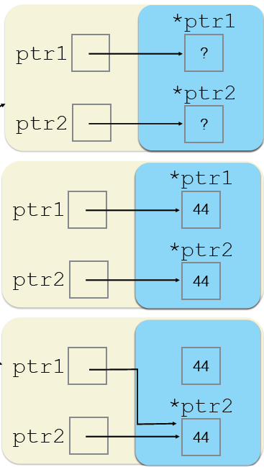
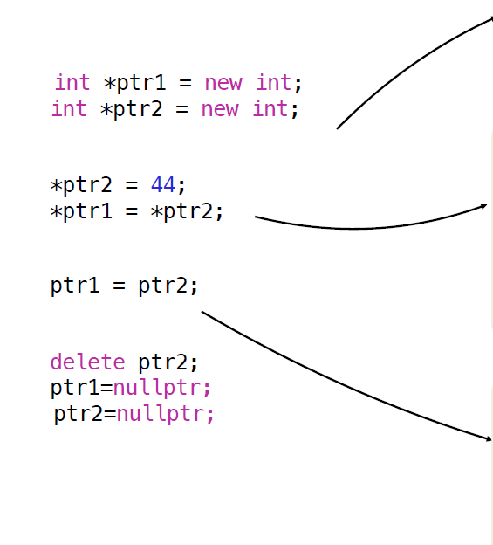
Memory Leak example

Slide 12
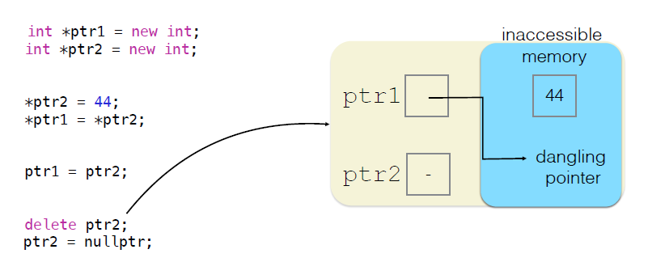
Memory Leak example

Slide 13
Exercise 6: Memory Leak in dynamic allocation
Write a C++ program that dynamically allocates memory for an integer array (arr1) of size 100 then reassigns the same pointer to a new array (arr2) of size 50.
Next, the program correctly deletes it using delete[], but the original arr2 array is never deallocated.
Your task is to run this program, identify where the memory leak occurs.
Explain why it happens.
Modify the program to fix the leak by ensuring that all dynamically allocated memory is properly released before the pointer is reassigned.

